Slide 1
Advanced Programming with Java
Prativa Nyaupane

Slide 2
What we have learned..
Setting up Java
Setting up IDE
Classes
Objects
Constructors
Packages

Slide 3
Today’s Objective
Variables and Data Types
Conditional Statements
Access Modifiers
Exception Handling
Java Collections

Slide 4
Variables
A variable is a container which holds the value, while the Java program is executed.
A variable is assigned with a data type.
A variable is the name of the memory location.
It is a combination of “vary + abled” - its value can be changed.
int rollNumber1 = 1;

Slide 5
Types of variables
Local Variable
A variable declared inside the body of a method.
Used only locally. Other methods do not have access to this variable.
Instance Variable
Declared inside the class but outside of body of a method.
Its value is instance-specific and not shared among instances.
Static Variable
Declared as static, shared among all the instances of the class
Memory allocation happens only once when the class is loaded in the memory.

Slide 6
public class Student {
private static int passingScore = 60;//global variable
int rollNumber; //instance(class) variable
int score;//instance(class) variable
public Student(int rollNumber, int score) {
this.rollNumber = rollNumber;
this.score = score;
}
public void checkIfStudentHasPassedOrNot() {
boolean hasPassed = false;//local variable, can only be used by this method
if (score >= passingScore) {
hasPassed = true;
} else {
hasPassed = false;
}
System.out.println("Student passed "+hasPassed);
}
}

Slide 7
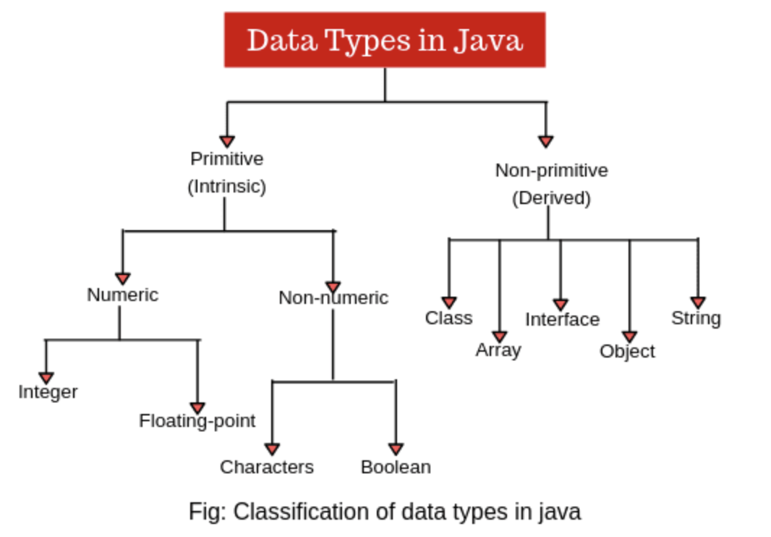
Data Types:
Type of values that can be stored in variables.
Broadly categorized into primitive(Intrinsic) and non-primitive(Derived)

Slide 8
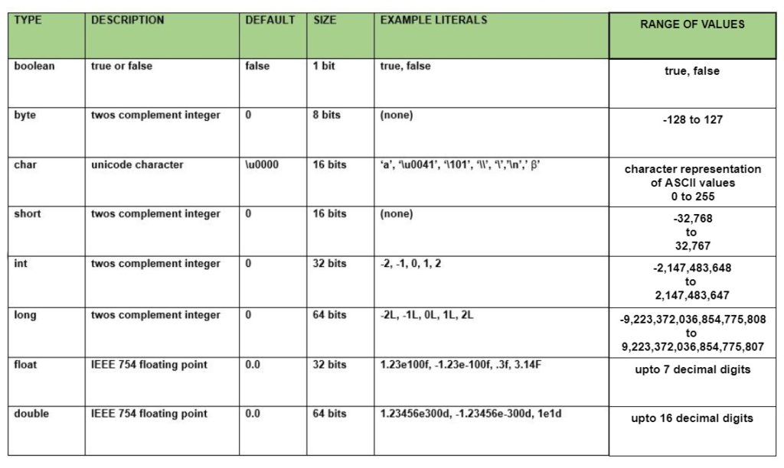
Primitive Data Types

Slide 9
Non-Primitive Data Types
Data types that do not hold a simple value directly but instead reference a memory location where the data is stored.
Created using classes, interfaces, arrays, and enums.
Classes | Interfaces | Arrays | Enums
Classes are user-defined data types that define the structure and behavior of objects. class Person { String name; int age; } | Interfaces are reference types that define a set of methods that a class must implement. interface Shape { void draw(); } | Arrays are used to store multiple values of the same data type in a single variable. int[] numbers = {1, 2, 3, 4, 5}; | Enums are a special type of class used to represent a fixed set of constants. Each constant value in an enum is an object of the enum type. enum Day { SUNDAY, MONDAY, TUESDAY, WEDNESDAY, THURSDAY, FRIDAY, SATURDAY }

Slide 10
Conditional Statements
Conditional Statements controls the flow of the execution of the program.
Java compiler executes the code from top to bottom.
The statements in the code are executed according to the order in which they appear. However, Java provides statements that can be used to control the flow of the Java code.

Slide 11
Types of Conditional Statements:
Decision Making statements
if statements
switch statement
Loop statements
for loop
for-each loop
Jump statements
break statement
continue statement

Slide 12
Decision Making Statements
public class Grade {
public static int passMarks = 50;
int marksObtained;
public Grade(int marksObtained) {
this.marksObtained = marksObtained;
if (marksObtained >= passMarks) {
handlePass(marksObtained);
} else {
handleFail();
}
}
public void handlePass(int marksObtained) {
int grade = marksObtained / 10;
switch (marksObtained) {
case 10:
System.out.println("Grade A");
break;
case 9:
System.out.println("Grade A");
break;
case 8:
System.out.println("Grade B");
break;
case 7:
System.out.println("Grade C");
break;
default:
System.out.println("Grade F");
}
}
public void handleFail() {
System.out.println("Student Failed");
}}

Slide 13
Loop Statements
Find sum of numbers from 1 to 10 using for loop
public void findSumOfNumbers(){
int sum = 0;
for(int i = 1; i <=10; i++){
sum = sum + i;
}
}
Find sum of numbers from 1 to 10 using for-each loop
public void findSumOfNumbersUsingForEach() {
int[] numbersToSum = {1, 2, 3, 4, 5, 6, 7, 8, 9, 10};
int sum = 0;
for(int number : numbersToSum){
sum = sum + number;
}
}

Slide 14
Access Modifiers
Java provides access modifiers to control the visibility and accessibility of classes, variables, and methods.
The access modifiers are "public", "protected", "private", and the default (no modifier).
"Public" allows access from anywhere, "protected" allows access within the same package or subclasses, "private" restricts access to within the class itself, and the default restricts access to the same package.
Access protection mechanisms ensure encapsulation, data hiding, and proper separation of concerns in an object-oriented system.

Slide 15
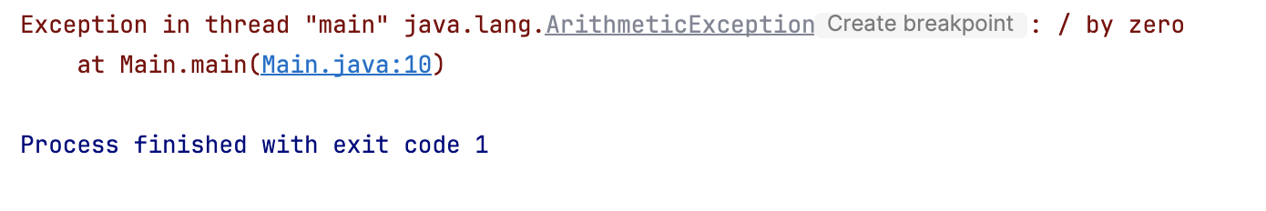
Exception Handling
The Exception Handling in Java is one of the powerful mechanism to handle the runtime errors so that the normal flow of the application can be maintained.
In Java, an exception is an event that disrupts the normal flow of the program.
It is an object which is thrown at runtime.
public class Main {
public static void main(String[]
args) {
System.out.println(1 / 0);
}}
The core advantage of exception handling is to maintain the normal flow of the application
An exception normally disrupts the normal flow of the application; that is why we need to handle exceptions

Slide 16
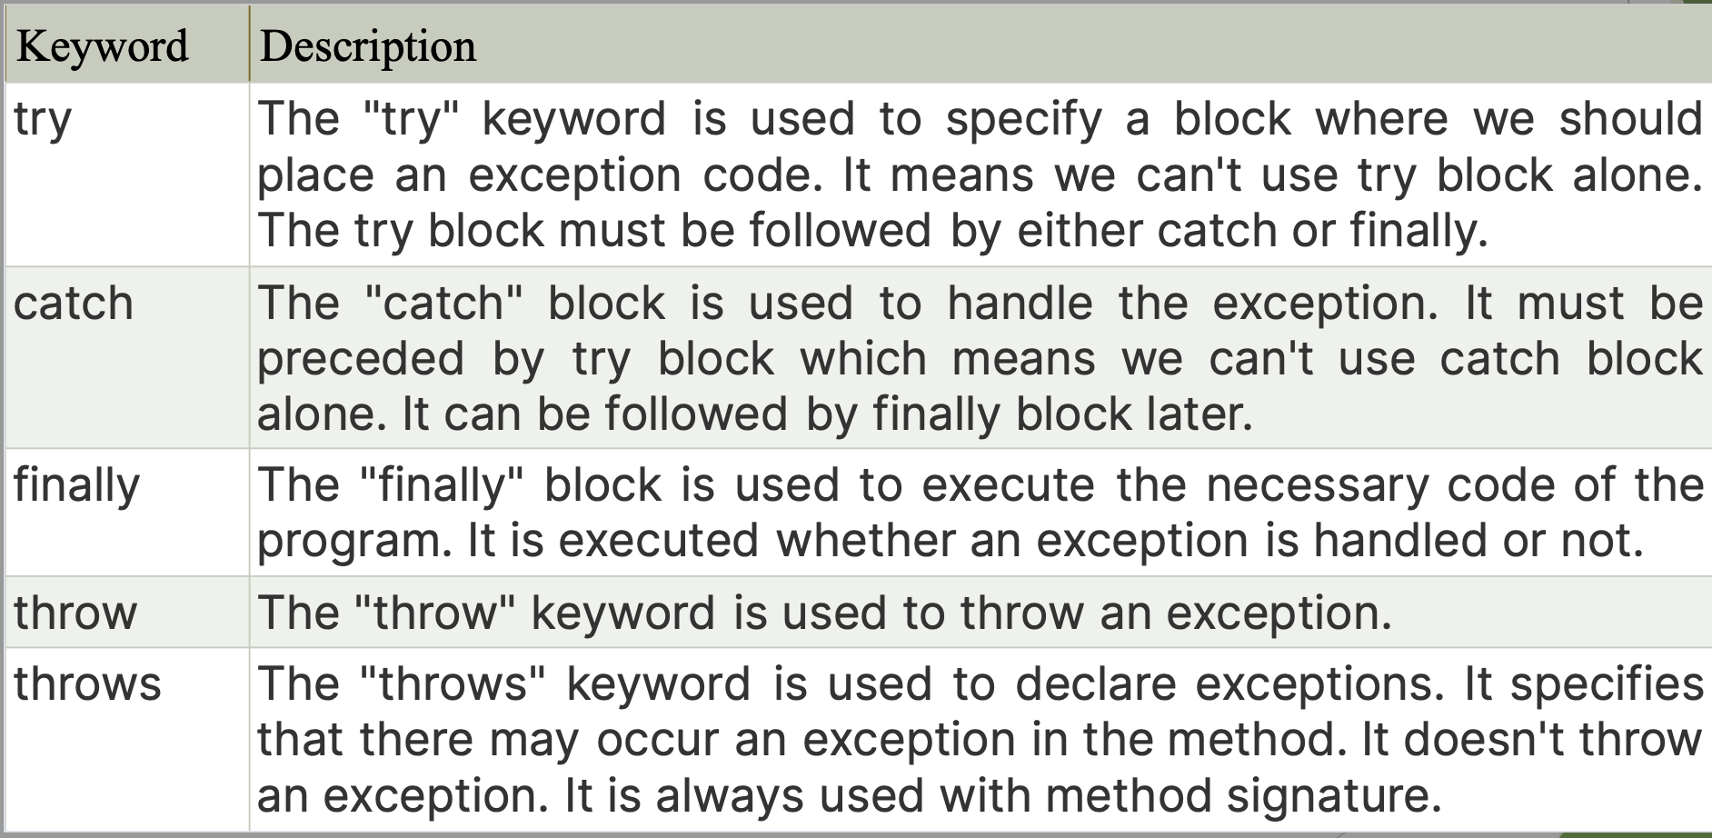
Exception Handling (contd…)

Slide 17
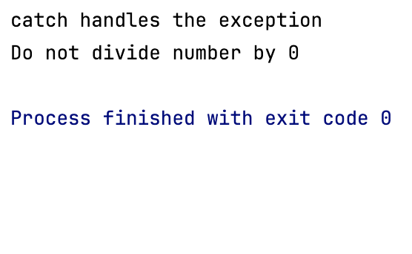
Exception Handling Contd..
public class Main {
public static void main(String[] args) {
try {
System.out.println(1 / 0);
}catch (ArithmeticException arithmeticException){
System.out.println("catch handles the exception");
}finally {
System.out.println("Do not divide number by 0");
}
}
}

Slide 18
Collections
The Collection in Java is a framework that provides an architecture to store and manipulate the group of objects
Java Collections can achieve all the operations that you perform on a data such as searching, sorting, insertion, manipulation, and deletion.
Java Collection means a single unit of objects.
Java Collection framework provides many interfaces (Set, List, Queue, Deque) and classes (ArrayList, Vector, LinkedList, PriorityQueue, HashSet, LinkedHashSet, TreeSet).

Slide 19
What is a framework in Java?
It provides readymade architecture.
It represents a set of classes and interfaces.
It is optional.

Slide 20
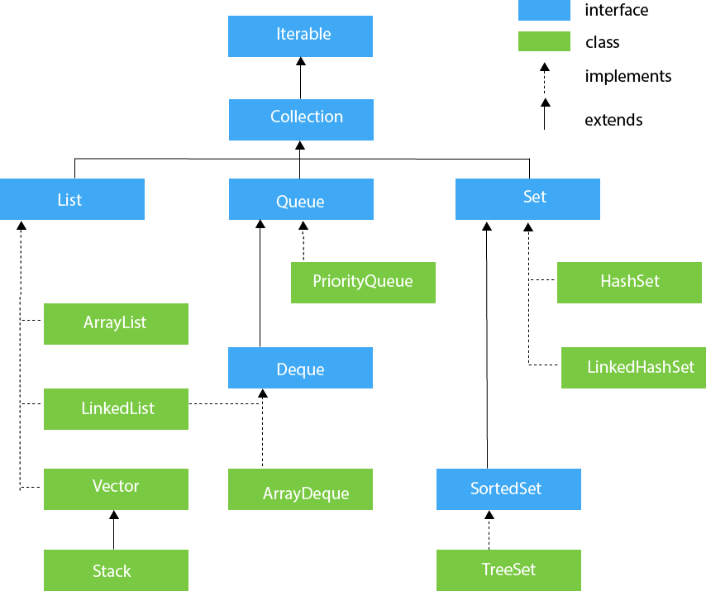
Hierarchy of Collection Framework

Slide 21
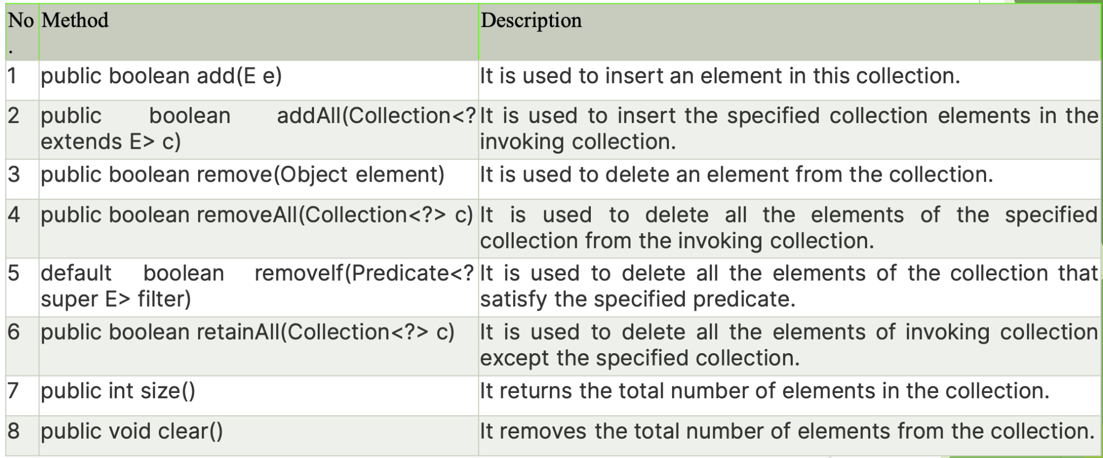
Methods of Collection Interface

